Slide 1

Scheduling

Slide 2
Scheduling
The operating system of a multi-tasking computer can have many programs running simultaneously in memory.
Each program is expected to run without any noticeable hesitation or delay.
This is made possible by using scheduling - the task of allocating CPU processor time amongst all running programs.

Slide 3
Scheduling
There are many reasons to have the operating system actively manage scheduling.
This is done by software within the operating system called a 'scheduler’, which ensures that the computer:
Makes efficient use of resources and processor
Ensures all jobs and/or users are processed fairly
Processes as many jobs as possible in least possible time
Prevents processes from failing to run
Provides a reasonable response time

Slide 4
Scheduling
Ensures that no task is left uncompleted for too long, even if they are low priority
Is able to prioritise jobs
Is able to alter priorities according to need
As you can see in the list above, the scheduler has many duties to fulfil.
The ideal scheduler would be one that is making 100% use of the CPU, no jobs are left hanging around and the user is never aware of a time delay (also no resources are left idle if a process is wanting to use them).

Slide 5
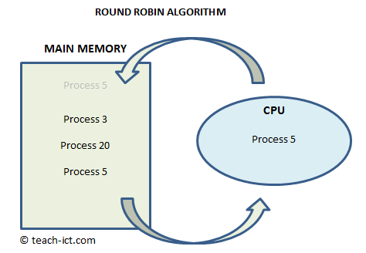
Round Robin
With the Round Robin scheduling algorithm each process is given an equal amount of time being processed.
A queue is made holding all processes that are ready to run and each process is loaded into main memory in turn and is given a set amount of CPU time to use.
If the process is completed during the allocated time then the next process in the queue is loaded immediately.
However, if the process is not finished when its time expires, it is put at the back of the queue to wait for another turn.

Slide 6
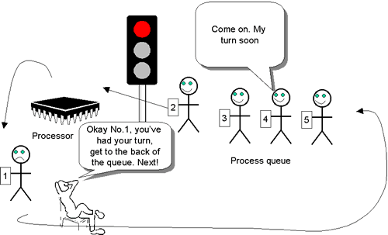
Round Robin
Advantage
It is simple to implement. Round Robin is a good algorithm if all the processes are more or less of similar priority and size.
Disadvantages
It does not take into account how important a process is (its priority). A high priority process has to wait just as long as very low priority processes to get its turn in main memory.
It does not consider that some processes are short and others long.

Slide 7
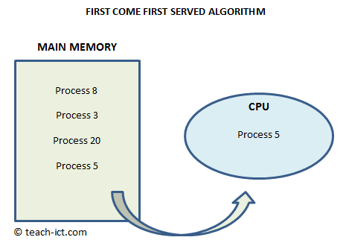
First Come First Served
Like the Round Robin algorithm, the "first come first served" algorithm lines up all processes ready to run in a 'first in first out' queue, ready to put into memory.
But unlike the Round Robin, each process is allowed to run to completion before the next one begins.
Once a job starts it prevents other jobs from being processed.
A job using a slow resource (e.g. printer) wastes processor time

Slide 8
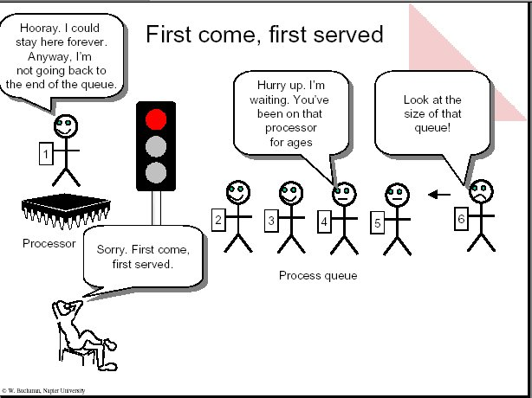
First Come First Served
Advantage
It is a simple algorithm to implement. It also ensures that once a process starts, it will run to completion in minimal time.

Slide 9
First Come First Served
Disadvantages
Once a job starts it prevents other jobs from being processed until it is completed
A job that needs to access a slow resource e.g. a printer, wastes processor time waiting for it
It does not take into account the priority of a process. High priority processes are put behind low priority ones if they arrive later.
It does not consider that some processes are short and others long. A long process will delay all the processes in the queue behind it.

Slide 10
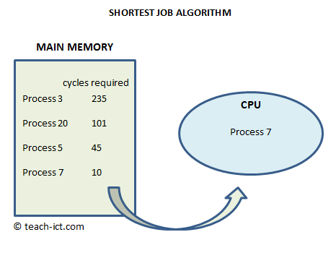
Shortest Job First
With the shortest job algorithm, the processes are arranged in a queue ordered by how much time (measured by the number of FDE cycles) each process needs in order to run to completion.
The diagram below shows process 3 will take 235 cycles to complete whilst process 7 will only take 10 cycles, so Process 7 will run to completion first.
The idea of this algorithm is to push as many processes as possible through the CPU in a given time - throughput is the priority.

Slide 11
Shortest Job First
If a new process comes along, the scheduler works out its processing time and it gets slotted into the queue at the appropriate point.
If it is shorter than any of the queue, the currently-running program is interrupted and the shorter one runs immediately.

Slide 12
Shortest Job First
Advantages
It ensures the maximum number of jobs are completed
It ensures that short jobs aren't kept waiting while long processes tie up CPU resources.
It minimises the average time a process takes to complete.

Slide 13
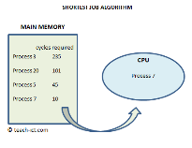
Shortest Job First
Disadvantages
Does not take into account the priority of a process. A process that is high priority but is very long will have to wait for all shorter processes to complete first, even if they are unimportant.
If a long job is nearly completed, it will still be interrupted and put back in the queue when a shorter job arrives.
The scheduler can only estimate how long a job will take to complete, but its estimation could be wrong.
Particularly long jobs may never complete if shorter jobs continually keep 'jumping the queue'.

Slide 14
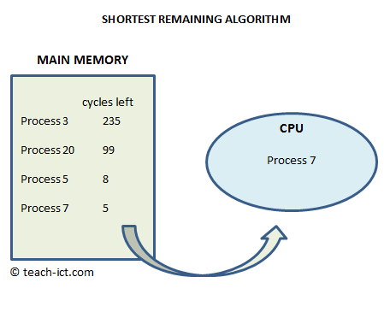
Shortest Time Remaining
One of the biggest issues with the Shortest Job First algorithm is that long jobs may never get completed when shorter jobs keep coming along.
Imagine a job 1000 cycles long gets to the front of the queue and starts running.
It will still be interrupted if a job 700 cycles long comes along even if it only has 1 cycle left until completion, since the total length of the new job is shorter than the total length of the old one.

Slide 15
Shortest Time Remaining
The "shortest remaining time" algorithm fixes this by instead ordering jobs by how much time they have remaining, rather than their total length.
If a process comes along requiring a certain number of cycles to finish, it gets slotted into the queue at the appropriate point.
Jobs will only be interrupted if the new process is shorter than the time remaining before completion.

Slide 16
Shortest Time Remaining
Advantages
It allows short processes to be handled very quickly
It ensures the maximum number of processes are completed in a given time, taking into account what has happened so far.

Slide 17
Shortest Time Remaining
Disadvantages
It does not take into account the priority of a process. High priority processes will remain at the back of the queue if they need a lot of time to complete, even if the jobs ahead of them are unimportant.
Particularly long jobs may never complete if shorter jobs continually keep 'jumping the queue'.

Slide 18
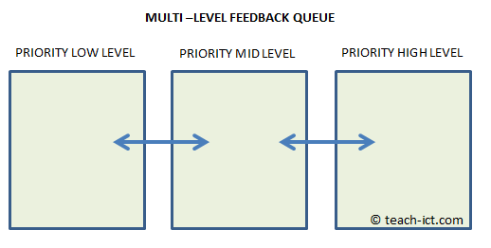
Multi-level Feedback Queues
The common disadvantage of all of the other algorithms we have discussed has been that they do not take into account the priority of the jobs.
One type of algorithm that does is 'multi-level feedback queue' algorithms.
These algorithms maintain a number of queues with different priority levels.

Slide 19
Multi-level Feedback Queues
Every job is given a priority by the scheduler when it arrives and is sorted into the relevant queue.
The queues themselves are sorted by one of the previously discussed algorithms.
The high priority queue is completed first, and then each of the lower level queues in turn.
The scheduler is able to re-prioritise jobs at any time, moving them into the queue appropriate for their new priority.
It may do this based on new information, or simply because a low priority job has been waiting for too long already.

Slide 20
Multi-level Feedback Queues
Advantages
Makes sophisticated use of process priority.
It ensures that higher priority processes run on time.
Disadvantages
Complex to implement.
Not very efficient if all jobs have similar priority.
Low priority jobs may take an extremely long time to complete if the queue algorithm doesn't compensate for wait-time, especially if new high-priority jobs keep arriving.

Slide 21
Summary
Scheduling algorithms include:
Round Robin - each job gets a fixed time slice
First Come First Served - the first job to arrive is processed until completion, then the next…
Shortest Job First - the quickest whole complete job is processed first
Shortest Remaining Time - quickest job left to complete is finished first
Multi-Level Feedback Queue - jobs are put in different queues depending on their importance. Other scheduling algorithms are then used on those queues

Slide 22
Conclusions
I am sure you are not surprised that there is no 'best' algorithm, otherwise every CPU maker would be using it.
In every real computer system from a personal workstation to a super-computer, the scheduler will have been designed to use a blend of algorithms, depending on what is happening in the system at that instant.
e.g. the scheduler may detect that most of the processes are of similar priority and processing length, in which case it switches to the Round Robin.
Then a moment later, some high priority processes appear, so it switches to the multi-level algorithm.

